Slide 1
Project Progress
Subject : Object Oriented Programming Topic : The Best Route in Cambodia Group : AMS-A-04 Lecture : Mr. Tal Tongsreng (Course) Mr. Chan Sophal (TP)

Slide 2
Our Member
Kry Senghort e20200706 Koythol Amrint e20201757 Lim Sunheng e20200807
Ek Vong Panharith e20200877
Buth Cheableng e20200861

Slide 3
Contents:
Data Collection:
- Phnom Penh Road List
- Province Road List
- National Road & Sub-National Road
- Distance from Phnom Penh to Provinces
- Distance from Province to Provinces
Code Implementation

Slide 4
1). Data Collection

Slide 5
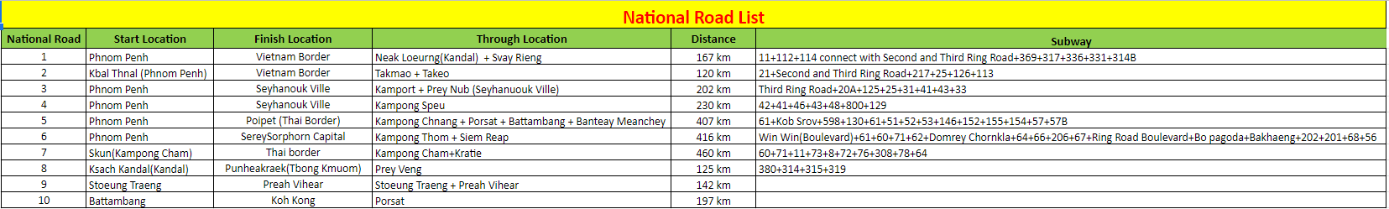
National Road & Sub-National Road List

Slide 6
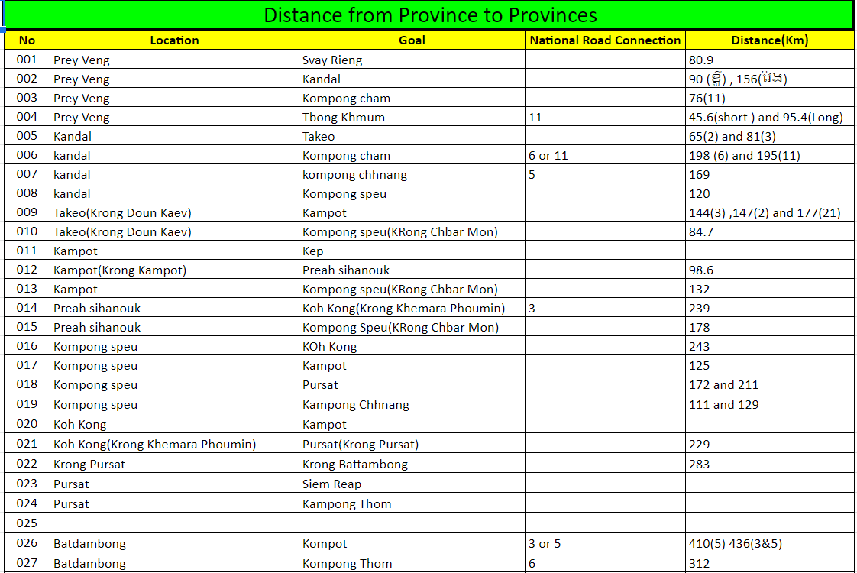
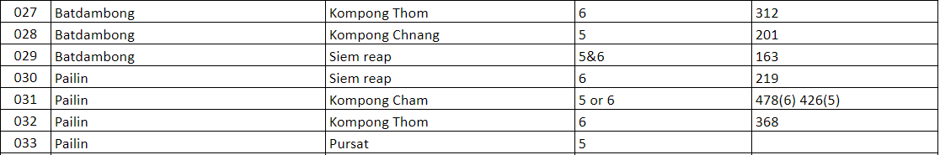
Distance from Province to Provinces

Slide 7
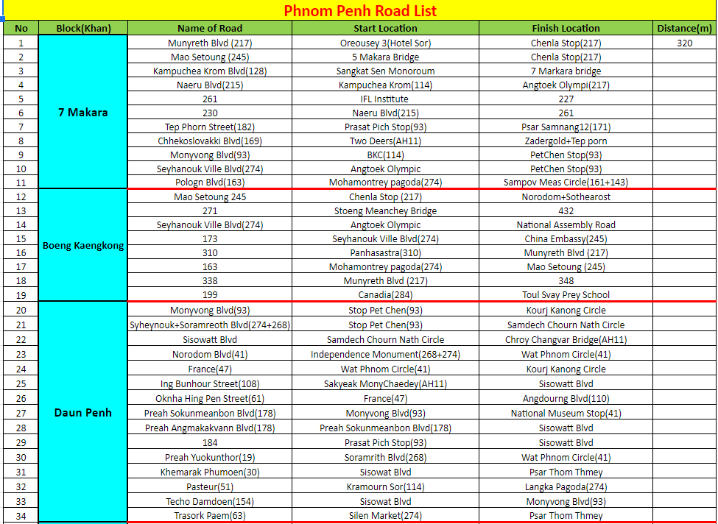
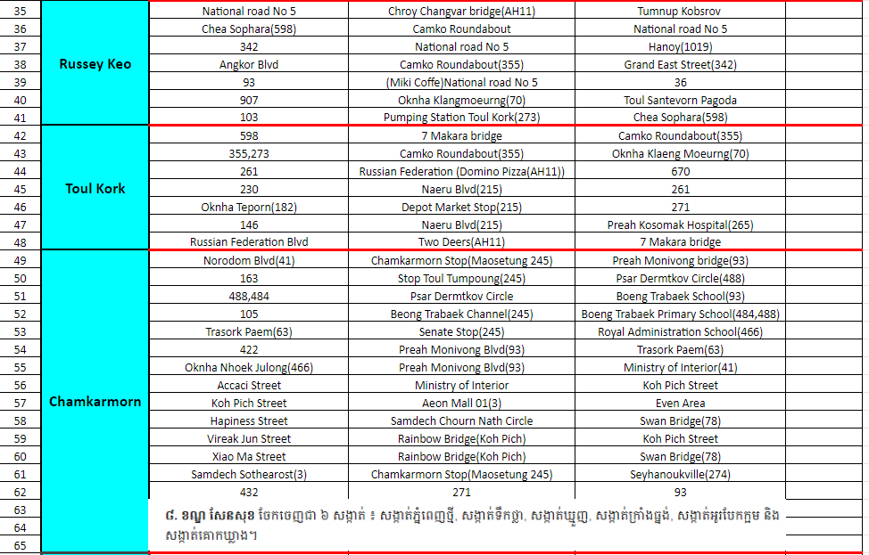
Phnom Penh Road List

Slide 8
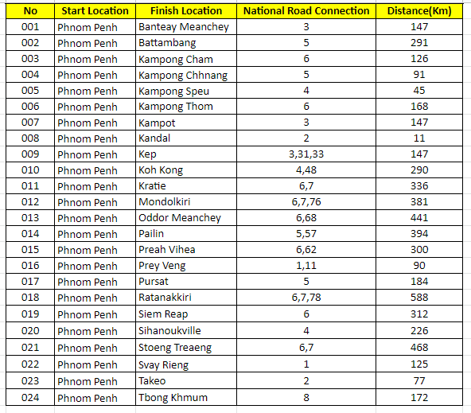
Distance from Phnom Penh to Provinces

